Slide 1


SMART WATER FOUNTAINS

Slide 2
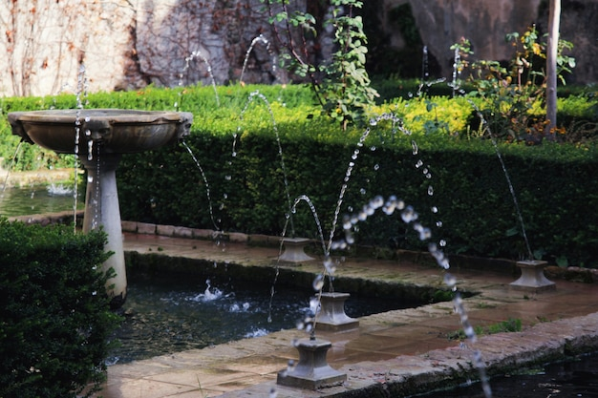
PROBLEM STATEMENT
The proliferation of smart water fountains in public spaces presents an intriguing opportunity for enhancing access to clean drinking water while also incorporating innovative technology into our daily lives. However, there is a pressing need to address several critical challenges to ensure the effective deployment and utilization of these intelligent hydration stations. One key issue revolves around the reliability and maintenance of these smart fountains, as their advanced features and components may be susceptible to technical glitches. This problem statement seeks to explore these multifaceted concerns and pave the way for the development of smarter, more accessible, and sustainable water fountain solutions in our urban environments. or wear and tear

Slide 3
TECHNOLOGICAL STACK
Design and Prototyping:
User Interface and Interaction
IoT Sensor Design
Sensor Integration
Data Management
Connectivity
Deployment and Scalability

Slide 4
Hardwares:
Power Supply: Connect the power supply (e.g., a 5V DC adapter) to your microcontroller and the water pump. Make sure to provide enough current for the pump and other components.
Microcontroller: Connect your microcontroller (e.g., Arduino) to the power supply. Connect the microcontroller's ground (GND) and 5V pins to the appropriate terminals on the power supply.
Water Pump: Connect the positive wire (usually red) from the water pump to a digital pin on your microcontroller (e.g., Pin 9) and the negative wire (usually black or brown) to the microcontroller's ground (GND).
Water Level Sensor: Connect the water level sensor to your microcontroller. Typically, these sensors have three pins: VCC, GND, and OUT. Connect VCC to 5V, GND to GND, and OUT to a digital input pin (e.g., Pin 2) on your microcontroller.

Slide 5
5.Temperature/Humidity Sensor (Optional): If you're using one, connect it to the microcontroller following the sensor's datasheet. Common options include DHT11 or DHT22 sensors.
6.LEDs (Optional): If you're adding LED lighting, connect them to appropriate digital pins on your microcontroller. Don't forget to include current-limiting resistors in series with the LEDs.
7.Wi-Fi Module (Optional): If you want to make your fountain "smart" and remotely controllable, connect a Wi-Fi module (e.g., ESP8266) to your microcontroller and follow the module's documentation for setup.
8.Tubing: Set up the tubing to ensure water flows from the pump to the desired locations in your fountain.

Slide 6

PROBLEM SOLUTION
The project aims to enhance public water fountains by implementing IoT sensors to control water flow and detect malfunctions. The primary objective is to provide real-time information about water fountain status to residents through a public platform. This project includes defining objectives, designing the IoT sensor system, developing the water fountain status platform, and integrating them using IoT technology and Python.

Slide 7
Conclusion
The integration of smart technology into water fountains represents a remarkable fusion of art, functionality, and efficiency. These intelligent water features not only add aesthetic appeal to outdoor and indoor spaces but also offer numerous practical advantages. Smart water fountains are designed to enhance user convenience by providing automated water circulation, water level monitoring, and even remote control options through Wi-Fi connectivity. Beyond their aesthetic and convenience-driven benefits, these fountains can also contribute to water conservation efforts by optimizing water usage and reducing wastage. As technology continues to evolve, the possibilities for innovation in the realm of smart water fountains are virtually limitless, promising a future where these enchanting installations serve as both captivating centerpieces and intelligent guardians of our water resources.

Slide 8
THANK YOU

